Slide 1


ADIDAS SALES ANALYSIS
CONTENT
Data Specification
Data Model
Key Variables
Problem Statement
Need
Visualizations
Dashboards
Filters Used

Slide 2

ADIDAS SALES ANALYSIS
DATA SPECIFICATION
File Type: Flat File (Excel)
No of Rows: 9649
No of Fields: 13
Connection Type: Flat File
No of Tables: 01

Slide 3
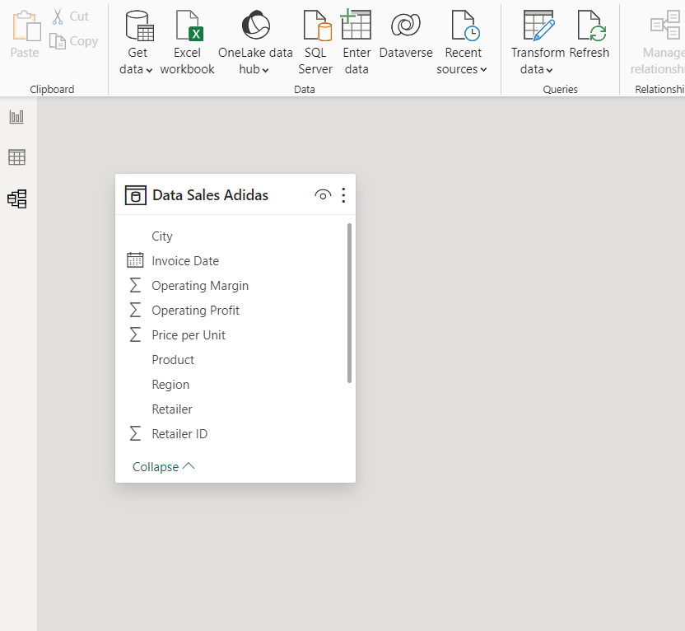

ADIDAS SALES ANALYSIS
DATA MODEL
Table Used: 01

Slide 4
ADIDAS SALES ANALYSIS
KEY VARIABLES
In our analysis there are some key metrics that we will be using in the dashboard are as follows
Total Sales
Operating Profit
Units Sold
Operating Margin

Slide 5
ADIDAS SALES ANALYSIS
PROBLEM STATEMENT
KPI’s (Key Point Indicators)
Total Sales Analysis:
Understand the overall sales performance of Adidas over time.
Profitability Analysis:
Evaluate the total profit generated by Adidas across different dimensions.
Sales Volume Analysis:
Examine the total units sold to gain insights into product demand.
Pricing Strategy:
Determine the average price per unit to assess the pricing strategy.
Margin Analysis:
Evaluate the average margin to understand the overall profitability of sales.

Slide 6
ADIDAS SALES ANALYSIS
PROBLEM STATEMENT
Charts Requirements
Total Sales by Month (Area Chart):
Visualize the monthly distribution of total sales to identify peak periods.
Total Sales by State (Filled Map):
Geographically represent total sales across different states using a filled map.
Total Sales by Region (Donut Chart):
Use a donut chart to represent the contribution of different regions to total sales.
Total Sales by Product (Bar Chart):
Analyze the sales distribution among various Adidas products using a bar chart.
Total Sales by Retailer (Bar Chart):
Visualize the contribution of different retailers to total sales using a bar chart.

Slide 7
ADIDAS SALES ANALYSIS
NEED
Through this Power BI-driven analysis, Adidas aims to empower its decision-makers with data-driven insights, fostering strategic growth and competitiveness in the dynamic sports and athletic industry.
Enhanced understanding of sales dynamics and performance drivers.
Identification of geographical areas with high and low sales potential.
Insights into product performance, aiding in inventory and marketing decisions.
Informed pricing and margin strategies for improved profitability.
Actionable recommendations for optimizing sales and profit across various dimensions.

Slide 8
ADIDAS SALES ANALYSIS
KPI’s
Total Sales:
Adidas has achieved a substantial total sales figure of $899.9 million, indicating a strong market presence and consumer demand for its products.
Total Profit:
The project showcases a commendable total profit of $332.1 million, reflecting effective cost management and revenue generation strategies.
Total Units Sold:
With a sales volume of 2.5 million units, Adidas demonstrates robust product demand and successful market penetration.
Average Price Per Unit:
The average price per unit is $45.2, suggesting a strategic pricing approach that balances affordability and value for consumers.
Average Margin:
The average margin of 42.3% highlights Adidas' ability to maintain a healthy balance between cost control and profitability.

Slide 9
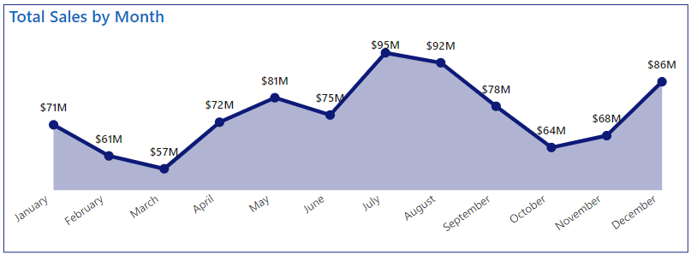
ADIDAS SALES ANALYSIS
Total Sales by Month
The analysis reveals a notable trend of maximum sales occurring in the months of July and August, reaching impressive figures of $95 million and $92 million, respectively.
This could include increased demand for sports and athletic apparel during the warmer months, potentially driven by outdoor activities, sports events, or seasonal fashion trends.

Slide 10
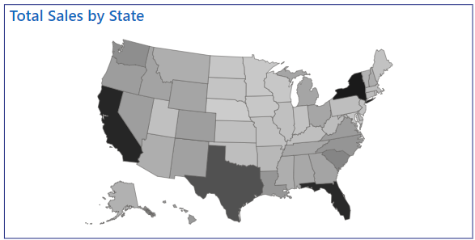
ADIDAS SALES ANALYSIS
Total Sales by State
The analysis reveals distinct regional variations in sales performance, with New York leading with $64.2 million, followed closely by California at $60.1 million, Florida at $59.2 million, and Texas at $46.3 million. Understanding these regional disparities is essential for targeted market strategies.
The highest sales in New York may be attributed to the urban influence, high population density, and strong consumer purchasing power. This insight suggests that Adidas products resonate particularly well in urban environments, warranting a focused marketing approach for metropolitan areas.

Slide 11
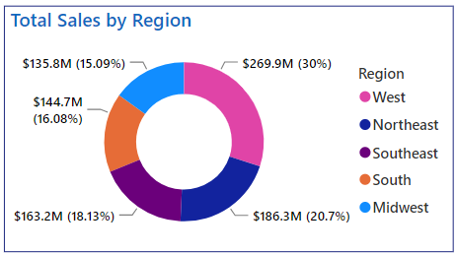
ADIDAS SALES ANALYSIS
Total Sales by State
The West Region emerges as the dominant contributor with a substantial sales figure of $269.9 million, accounting for 30% of the total sales.
The Northeast region follows closely with sales totaling $186.3 million, contributing 21% to the overall sales.
The Southeast region, with sales totaling $163.2 million, makes a substantial contribution of 18.13% to the overall sales.

Slide 12
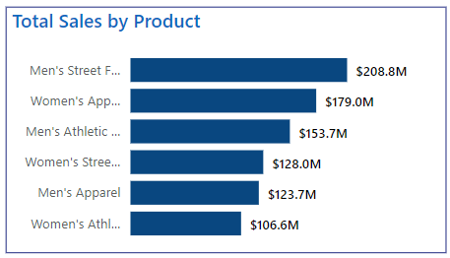
ADIDAS SALES ANALYSIS
Total Sales by State
Men's Street Footwear emerges as the top-performing category with maximum sales of $208.8 million.
Women's Apparel follows closely with sales totaling $179 million, showcasing a substantial market share.
Analyzing the success of Mens Street Footwear and Womens Apparel provides valuable consumer insights. Understanding the factors driving sales in these categories can guide product development strategies, ensuring that future offerings align with consumer preferences and market trends.

Slide 13
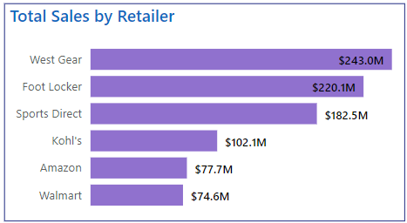
ADIDAS SALES ANALYSIS
Total Sales by State
West Gear Retailer emerges as the top-performing retailer, boasting sales of $243 million. This retailer's dominance in sales suggests a strong market presence and consumer appeal in the western region.
Foot Locker follows closely with sales totaling $220 million, indicating a significant market share and consumer trust in this popular athletic and footwear retailer.
The disparity in sales between West Gear Retailer and Foot Locker may be influenced by regional dynamics, consumer preferences, and marketing strategies.

Slide 14
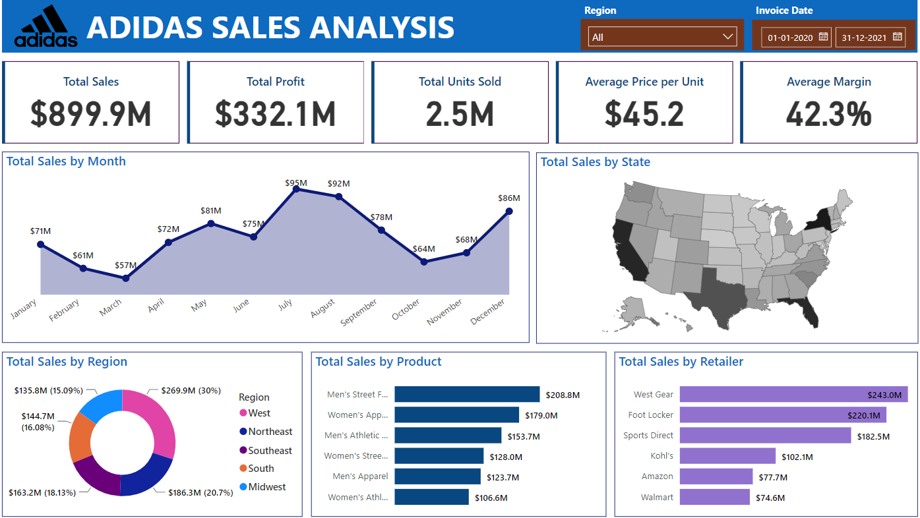
ADIDAS SALES ANALYSIS
Dashboard

Slide 15

ADIDAS SALES ANALYSIS
Filters Used
Region:
The inclusion of a "Region" filter allows users to dynamically analyze and compare sales data across different geographical areas. Users can select specific regions of interest, such as West, Northeast, Southeast, etc., to gain insights into regional sales trends, performance variations, and market dynamics.
Invoice Date:
The "Invoice Date" filter enables users to focus on specific time periods or analyze sales data over different months or years. This filter is valuable for tracking seasonal patterns, identifying trends, and assessing the impact of time-related factors on sales performance. Users can select custom date ranges or predefined time intervals for detailed analysis.

